Slide 1

Simple Black & White presentation

Slide 2

Hello!
I am Jayden Smith
I am here because I love to give presentations.
You can find me at @username

Slide 3
Transition headline
1.
Let’s start with the first set of slides

Slide 4
Quotations are commonly printed as a means of inspiration and to invoke philosophical thoughts from the reader.

Slide 5
This is a slide title
Here you have a list of items
And some text
But remember not to overload your slides with content
Your audience will listen to you or read the content, but won’t do both.

Slide 6
BIG CONCEPT
Bring the attention of your audience over a key concept using icons or illustrations

Slide 7
You can also split your content
White
Is the color of milk and fresh snow, the color produced by the combination of all the colors of the visible spectrum.
Black
Is the color of coal, ebony, and of outer space. It is the darkest color, the result of the absence of or complete absorption of light.

Slide 8
In two or three columns
Yellow
Is the color of gold, butter and ripe lemons. In the spectrum of visible light, yellow is found between green and orange.
Blue
Is the colour of the clear sky and the deep sea. It is located between violet and green on the optical spectrum.
Red
Is the color of blood, and because of this it has historically been associated with sacrifice, danger and courage.

Slide 9
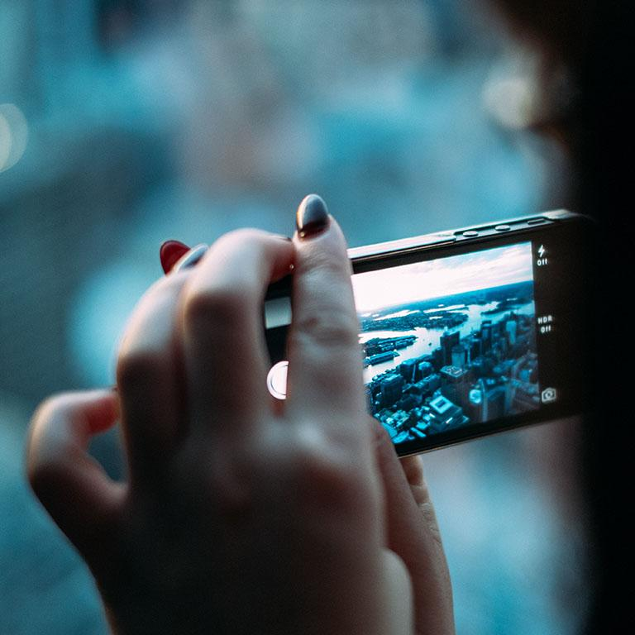
A picture is worth a thousand words
A complex idea can be conveyed with just a single still image, namely making it possible to absorb large amounts of data quickly.

Slide 10
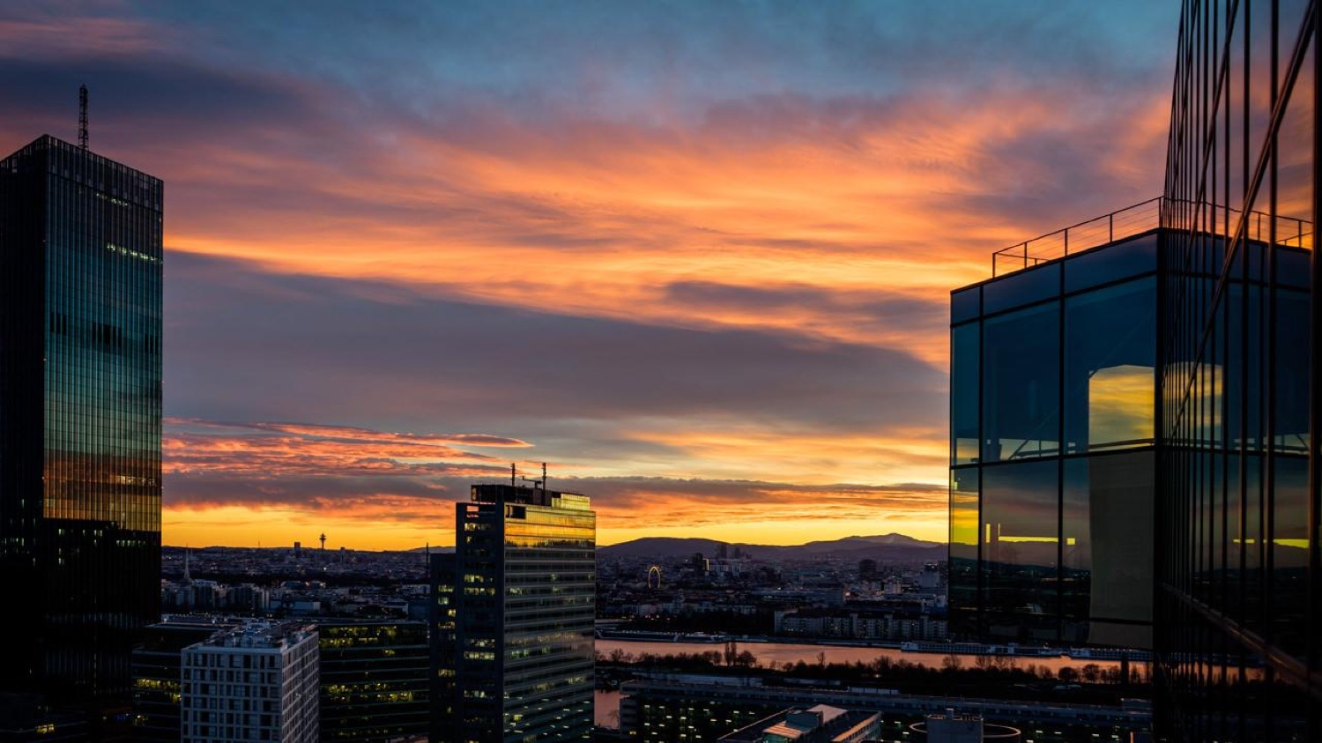
Want big impact? Use big image.

Slide 11
Use charts to explain your ideas
Gray
White
Black

Slide 12
And tables to compare data
 | A | B | C
Yellow | 10 | 20 | 7
Blue | 30 | 15 | 10
Orange | 5 | 24 | 16

Slide 13
89,526,124
Whoa! That’s a big number, aren’t you proud?

Slide 14
89,526,124$
185,244 users
100%
That’s a lot of money
And a lot of users
Total success!

Slide 15
Our process is easy
first
second
last

Slide 16
Let’s review some concepts
Yellow
Is the color of gold, butter and ripe lemons. In the spectrum of visible light, yellow is found between green and orange.
Blue
Is the colour of the clear sky and the deep sea. It is located between violet and green on the optical spectrum.
Red
Is the color of blood, and because of this it has historically been associated with sacrifice, danger and courage.
Yellow
Is the color of gold, butter and ripe lemons. In the spectrum of visible light, yellow is found between green and orange.
Blue
Is the colour of the clear sky and the deep sea. It is located between violet and green on the optical spectrum.
Red
Is the color of blood, and because of this it has historically been associated with sacrifice, danger and courage.

Slide 17
Thanks!
Any questions?
You can find me at
@username
user@mail.me

Slide 18
Credits
Special thanks to all the people who made and released these awesome resources for free:
Presentation template by SlidesCarnival
Photographs by Unsplash

Slide 19
Presentation design
This presentation uses the following typographies:
Titles: Work sans bold
Body copy: Work sans light
You can download the fonts on this page:
https://github.com/weiweihuanghuang/Work-Sans/tree/master/fonts/desktop
You don’t need to keep this slide in your presentation. It’s only here to serve you as a design guide if you need to create new slides or download the fonts to edit the presentation in PowerPoint®

Slide 20
SlidesCarnival icons are editable shapes.
This means that you can:
Resize them without losing quality.
Change fill color and opacity.
Change line color, width and style.
Isn’t that nice? :)
Examples:

Slide 21
😉
Now you can use any emoji as an icon!
And of course it resizes without losing quality and you can change the color.
How? Follow Google instructions https://twitter.com/googledocs/status/730087240156643328
✋👆👉👍👤👦👧👨👩👪💃🏃💑❤😂😉😋😒😭👶😸🐟🍒🍔💣📌📖🔨🎃🎈🎨🏈🏰🌏🔌🔑 and many more...

